Slide 1
Cognitive abilities
Dr J Balamurugan

Slide 2
ability
Ability refers to the relatively stable capabilities of people have to perform a particular range of different and/or related activities.
It also refers that the talent, skill, or proficiency in a particular area.
Ability is relatively stable.
Abilities are a function of both genes and the environment.

Slide 3
COGNITIVE ABILITIS
Cog­ni­tion has to do with how a per­son under­stands and acts in the world. It is a set of abil­i­ties, skills or processes that are part of nearly every human action.
Cog­ni­tive abil­i­ties are brain-based skills we need to carry out any task from the simplest to the most com­plex.
They have more to do with the mech­a­nisms of how we learn, remem­ber, problem-solve, and pay atten­tion rather than with any actual knowl­edge.
It also includes the mental process of knowing, including aspects such as awareness, perception, reasoning, and judgment.

Slide 4
Kinds of cognitive ability
Verbal ability
Quantitative ability
Reasoning ability
Spatial ability
Perceptual abilities

Slide 5
Verbal ability
Verbal ability refers to various capabilities associated with understanding and expressing oral and written communication.
Oral comprehension is the ability to understand spoken words and sentences.
Written comprehension is the ability to understand written words and sentences.
Oral expression refers to the ability to communicate ideas by speaking.
Written expression refers to the ability to communicate ideas in writing.
Generally speaking, verbal abilities are most important in jobs in which effectiveness depends on understanding and communicating ideas and information to others.

Slide 6
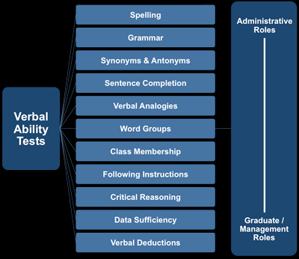
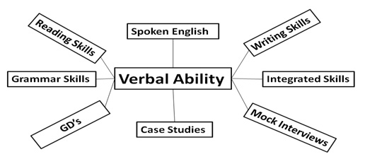
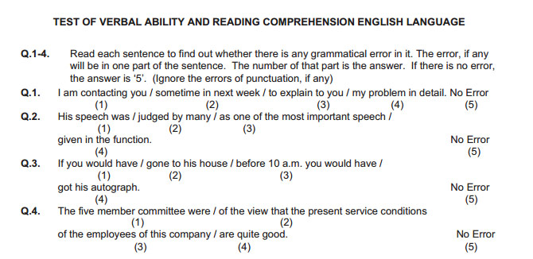

Slide 7
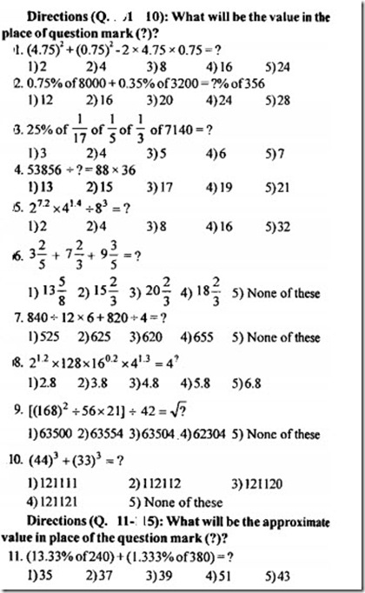
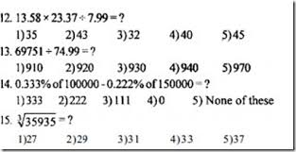
Quantitative ability
Quantitative ability refers to two types of mathematical capabilities.
Number facility is the capability to do simple maths operations (adding, subtracting, multiplying, and dividing).
Mathematical reasoning refers to the ability to choose and apply formulas to solve the problems that involve numbers.

Slide 8
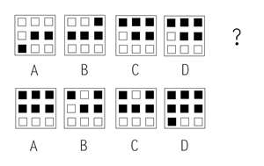
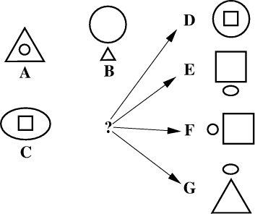
Reasoning ability
Reasoning ability is actually a diverse set of abilities associated with sensing and solving problems using insight, rules, and logic.
Problem sensitivity is the ability to sense that there’s a problem right now or likely will be one. (understand the problem)
Deductive reasoning refers to the use of general rules to solve problems.
Inductive reasoning refers to the ability to consider several specific pieces of information and then reach a more general conclusion regarding how those pieces are related.
Originality refers to the ability to develop clever and novel ways to solve problems.

Slide 9
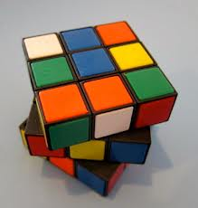
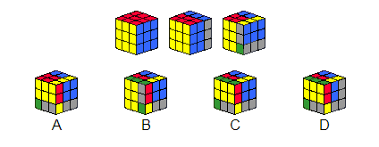
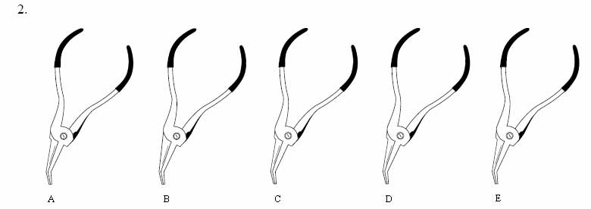
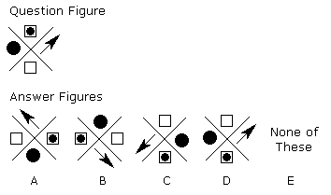
Spatial ability
Spatial ability refers to the capabilities associated with visual and mental representation and manipulations of objects in space.
Spatial orientation refers to having a good understanding of which/where one is relative to other things in the environment.
Visualization is the ability to imagine how separate things will look if they were put together in a particular way.

Slide 10
Perceptual ability
Perceptual abilities generally refer to being able to perceive, understand, and recall patterns of information.
It is the capacity of person to accurately interpret or give meaning to what is seen.
Generally a number of specific skills fall into this category including visual discrimination or the ability to distinguish one visual pattern from another.
Speed and flexibility of closure refers to being able to pick out a pattern of information quickly in the presence of distracting information, even without all the information present.
Perceptual speed refers to being able to examine and compare numbers, letters, and objects quickly.

Slide 11
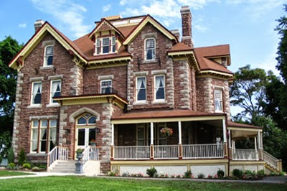
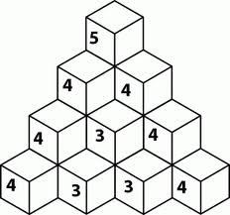
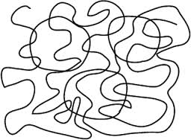
Perceptual ability test

Slide 12
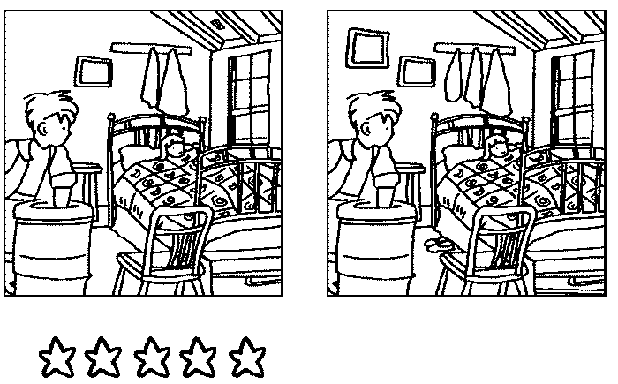
Perceptual ability

Slide 13
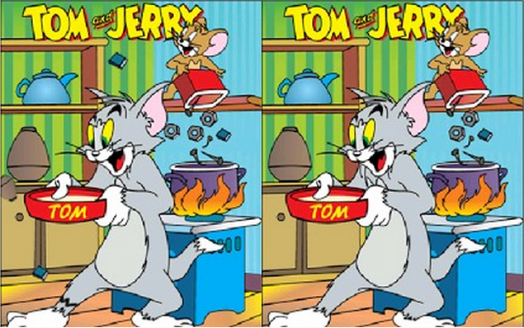
Perceptual ability

Slide 14
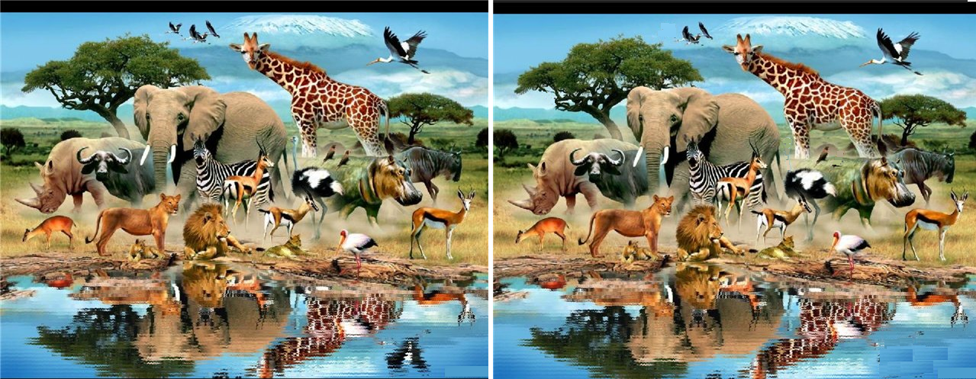
Perceptual ability

Slide 15
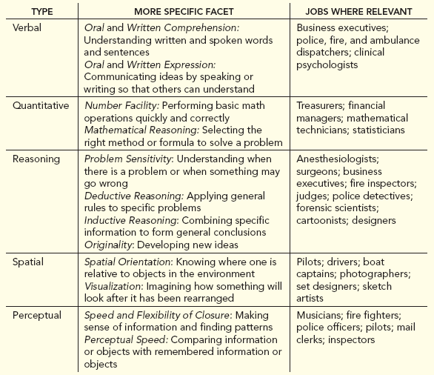
Types and facts of cognitive abilities

Slide 16
Ways to Improve cognitive abilities
Physical Activity
Openness to Experience
Curiosity and Creativity
Social Connections
Mindfulness Meditation
Brain-Training Games
Get Enough Sleep
Reduce Chronic Stress

Slide 17
Thank you

